Slide 1
Investigating a malicious script in Microsoft Intune: A DFIR case study
SANS DFIR Summit 2025

Slide 2
Contents
1
Agenda
2
Baseline Intune
3
Forensic analysis
4
Tools used
5
Research
6
Summary

Slide 3


whoami
whoami
Dennis Labossiere
experience.ps1 --job --degrees All --years --certs All
Director within the KPMG Cyber Threat Management practice
BS degree from Utica College (n/k/a Utica University) in cybercrime forensics and investigations
MS degree from Utica College (n/k/a Utica University) in computer forensics and cyber operations
Ten years of DFIR experience
SANS GCFA
SentinelOne Incident Response Engineer
MITRE ATT&CK Defender CTI and Adversary Emulation
cyber_passions.ps1 --all
Threat hunting and detection engineering
Ransomware investigations
personal.ps1 --all
Husband and father
Former collegiate baseball player
Glamor camper (camping with electric hookup) who loves to fish and cook

Slide 4

WIIFM?
We all have something to learn (e.g., defensive measures, new analytic technique, or a new data source).
Reminder to leverage all available telemetry:
Think about what data may be available aside from host-based or cloud-based forensics.
Share a story from the trenches.
Maybe a new detection can be created based on events in this presentation.

Slide 5
Caveats
I built a test environment for this presentation.
It contained one Windows 10 virtual desktop, which was joined to Microsoft Entra ID and managed by Intune.
I used free trials versions for Microsoft Entra ID (P2) and Intune (release 2401).
I did not:
Enable PowerShell auditing ☹
Enable third-party integrations and/or EDR/XDR
Forward logs to SIEM / data lake

Slide 6
Agenda
1

Slide 7
Agenda
01
Provide a brief background on a real intrusion that inspired this research and presentation.
02
Baseline Microsoft Intune using a newly established testing domain.
03
Describe the methodology and available telemetry so you can perform a similar investigation.
04
Recreate the attack in a lab environment and forensically analyze the attack that inspired this research and presentation.
05
NOTE: Where appropriate, redactions or implicit changes were made to protect credentials, secrets and/or domains.
List the tools used to analyze the attack.
06
Provide the research that assisted with this presentation.

Slide 8
Incident background
At approximately 00:33 UTC on June 10, 2023, KPMG responded to an incident where a remote attacker successfully gained unauthorized access into a client’s Azure tenant.
Upon initial investigation, it was discovered that the remote attacker obtained access to a highly privileged account.
On June 13, 2023, analysis indicated that a script within Microsoft Intune—named Teams Firewall updater—was modified by the remote attacker.
This remote attacker was likely a part of the group known as Scattered Spider (aka Octo Tempest, Starfraud, UNC3944, and many other monikers).
The underlying PowerShell script was named Update-TeamsFWRules.ps1.
The script was modified to download and install an application that provided remote access.
This remote access was further leveraged and used to download additional tools.

Slide 9
Baseline Intune
2

Slide 10
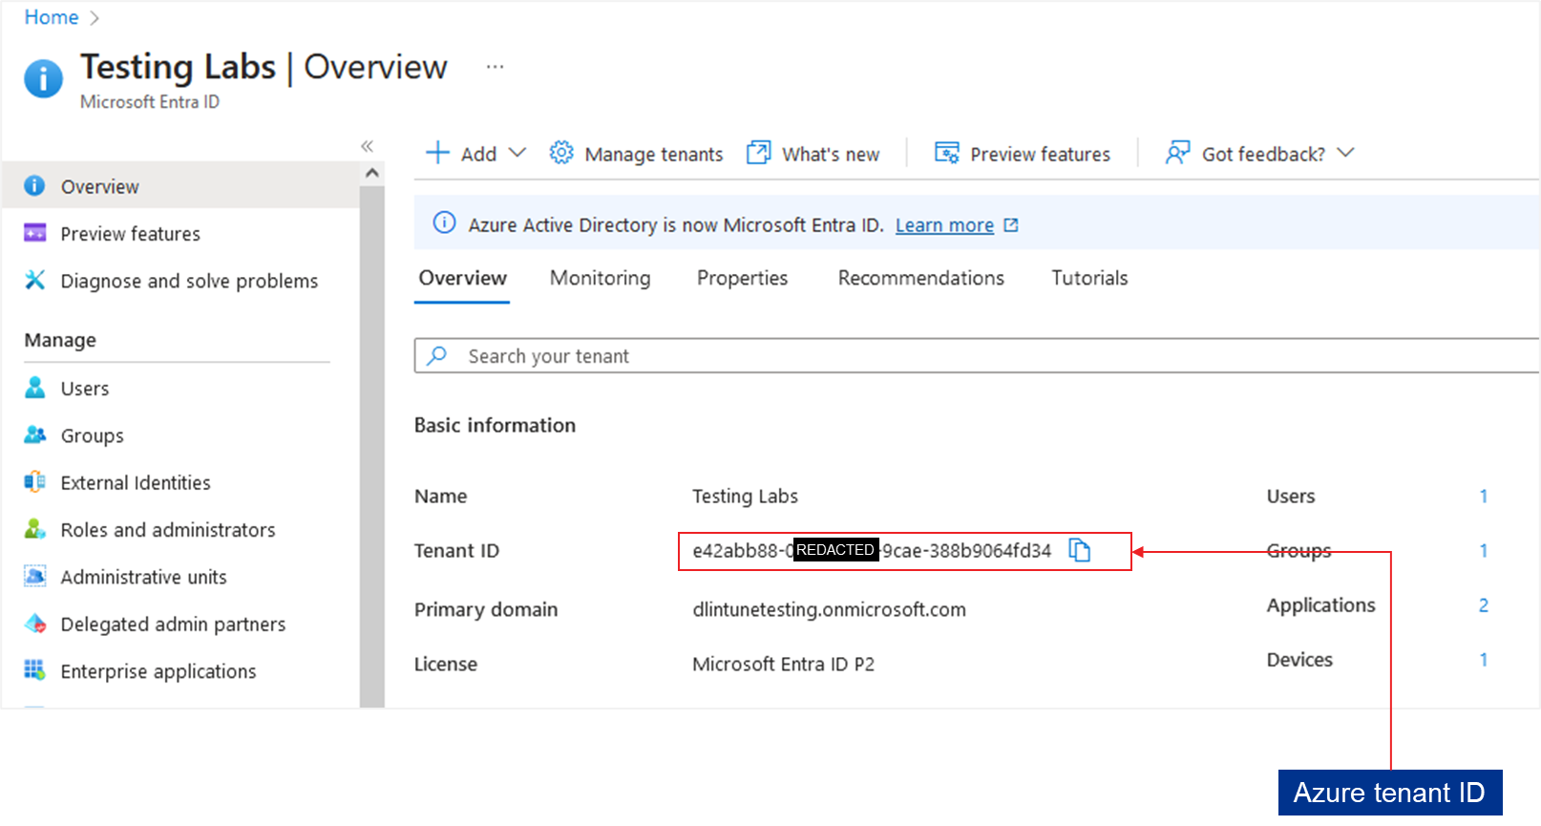
Azure tenant details

Slide 11
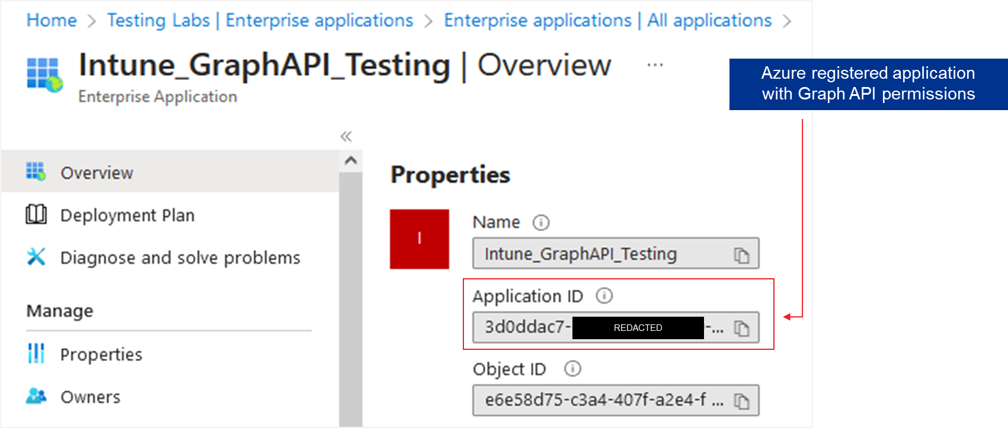
Azure Enterprise application details

Slide 12
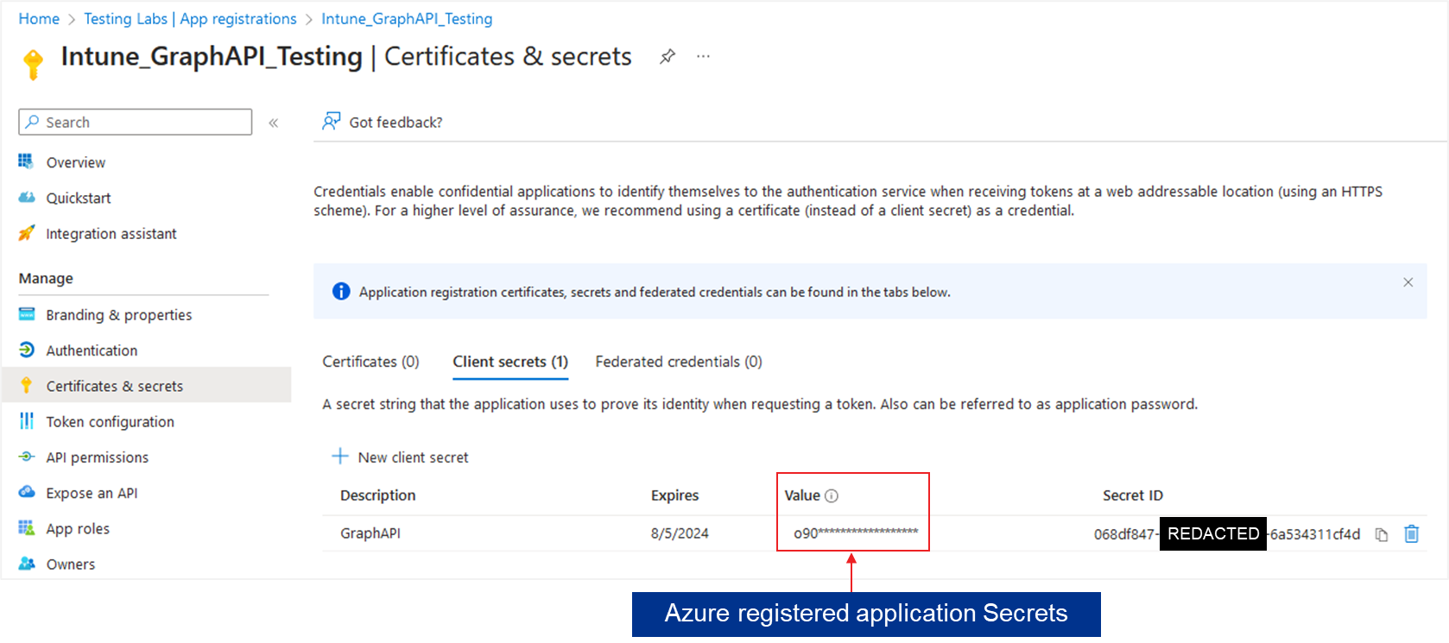
Azure registered application details

Slide 13
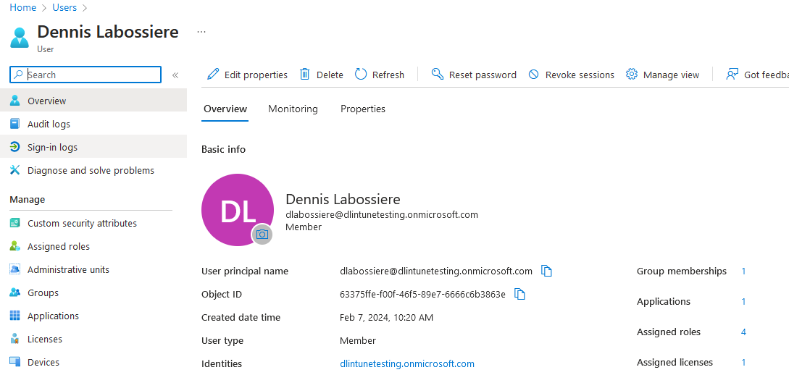
Azure user details
The Object ID value is used to track the user responsible.

Slide 14
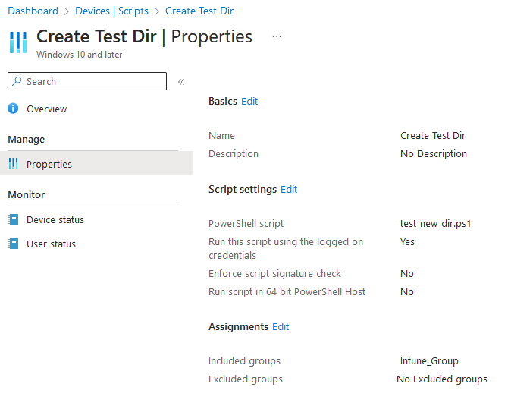
Baseline Intune
Note: By default, the end point will check for policy updates every 60 minutes.
By default, Intune does not have preexisting scripts.
Two benign scripts were created:
01
The first script created a directory on the desktop of user1 with the name of Test.
02
The second script created a directory on the desktop of user2 with the name of Test.
Specific script properties were noted:
Name of the script
ScriptID (from the URL or Graph API)
PowerShell script name
Run as logged on user option
Included and excluded groups

Slide 15
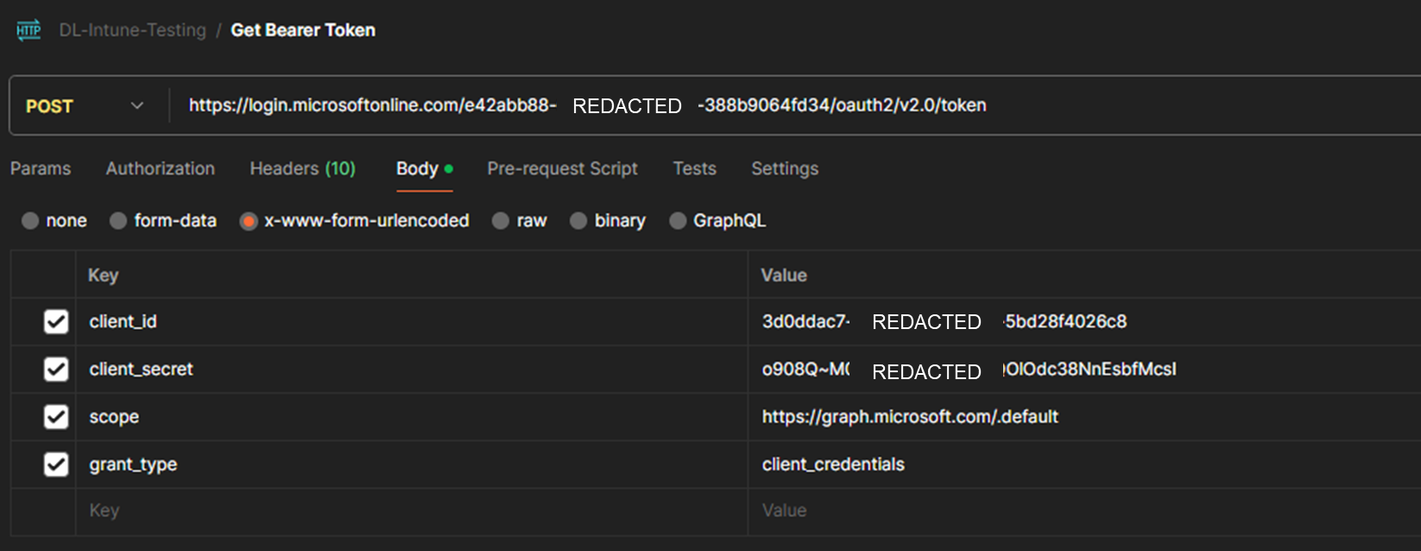
Baseline Intune – Microsoft Graph API
Send a POST to https://login.microsoft.com/<AZURE TENANT ID>/oauth2/v2.0/token to obtain a Bearer token.

Slide 16
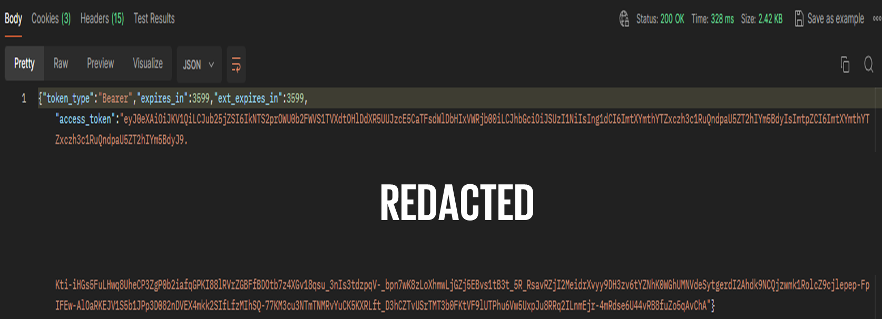
Baseline Intune – Microsoft Graph API – Bearer Token received
After providing the required key value pairs, a Bearer token is provided.

Slide 17
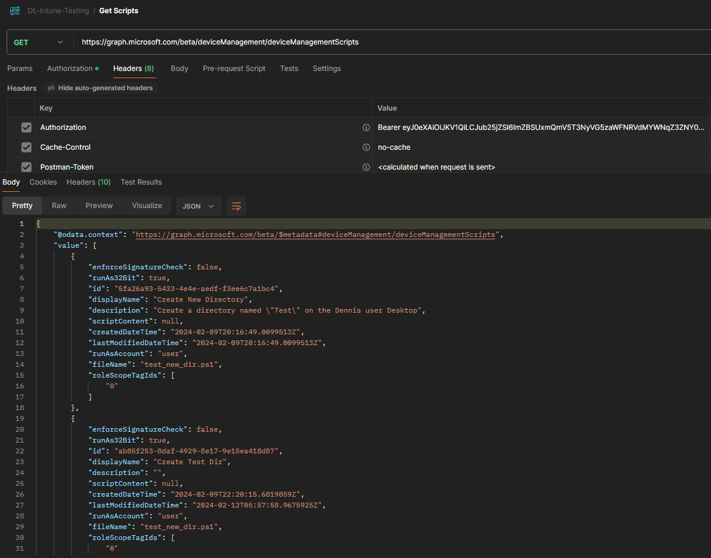
Baseline Intune – Microsoft Graph API (continued)
Send a GET to https://graph.microsoft.com/beta/deviceManagement/deviceManagementScripts to obtain the Intune script details.

Slide 19
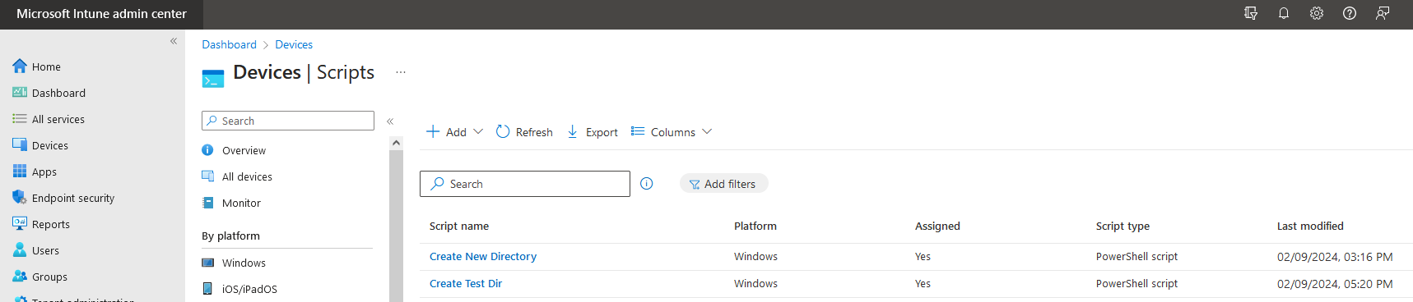
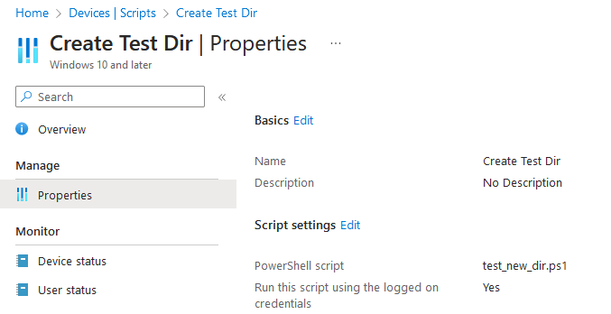
Time zone is EST
Time zone is EST
API details align with Intune details and time zone is UTC

Slide 20
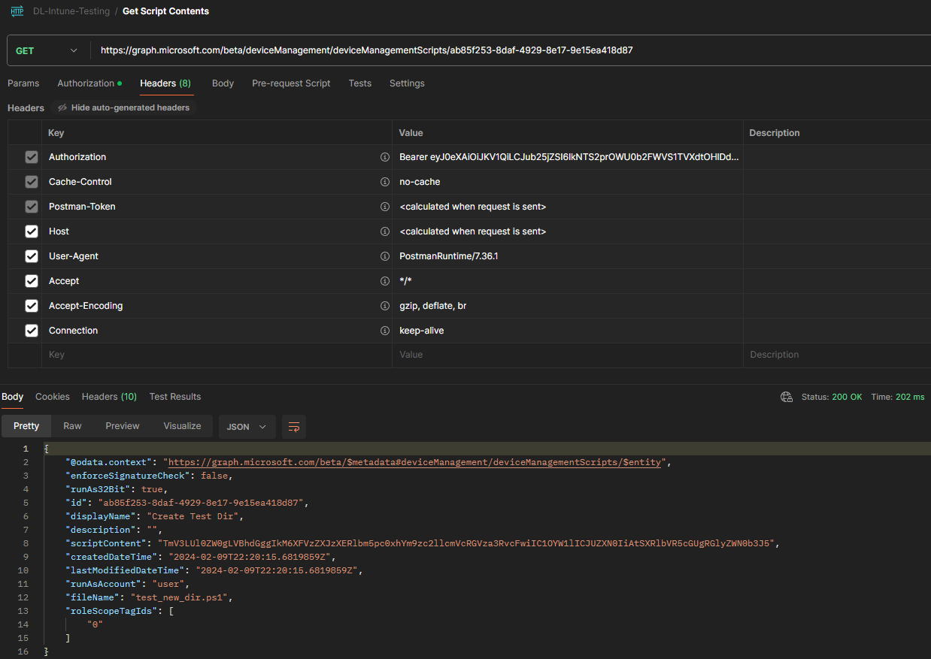
Baseline Intune – Microsoft Graph API (continued)
Send a GET to https://graph.microsoft.com/beta/deviceManagement/deviceManagementScripts/<ScriptID> to obtain additional script details plus the Base64 encoded contents of the underlying PowerShell script.

Slide 22
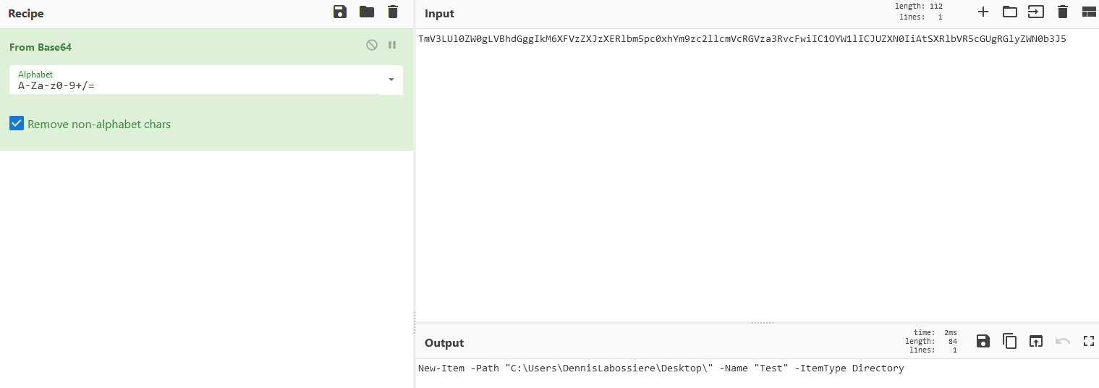
Baseline Intune – Microsoft Graph API – Decoding script contents
Using CyberChef we can decode the Base64 contents with ease.
REDACTED

Slide 23
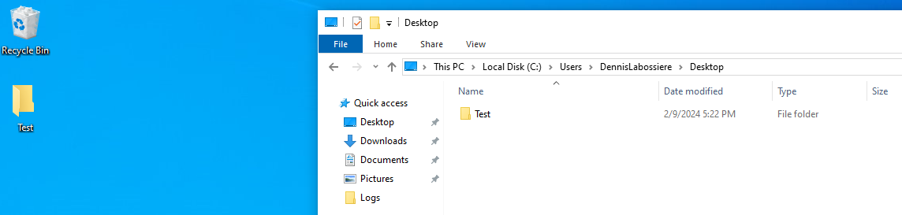
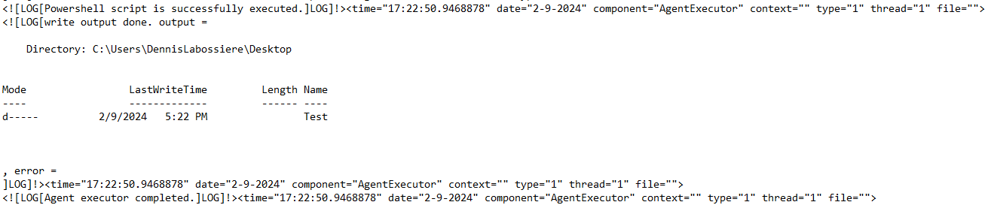
Baseline Intune – Results on the end point
REDACTED
Preview of forensic analysis to come

Slide 24
Forensic analysis
3

Slide 25
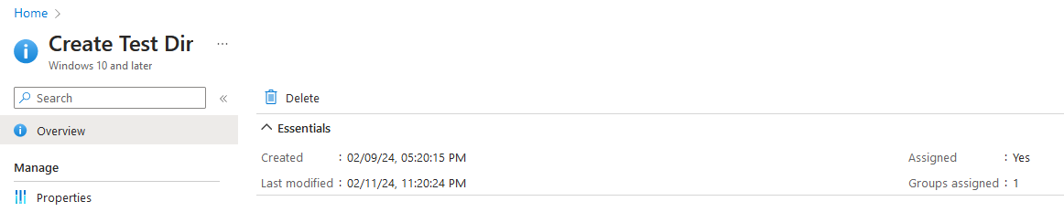
What happens to modified scripts?
When a script is modified, the Last modified date will be updated:
The scriptID does not change even if the script contents are completely altered.
REDACTED

Slide 26
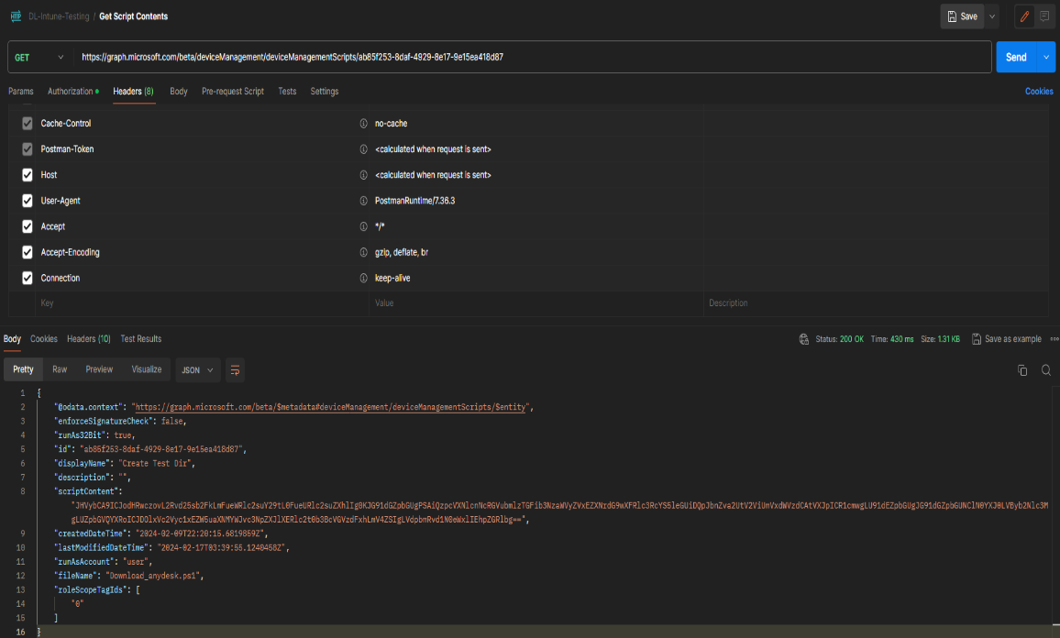
Forensic analysis – Microsoft Graph API
The script was modified, and leveraging the API, we can see the modification time and updated PowerShell script contents.

Slide 27
ORIGINAL SCRIPT

Slide 28

MODIFIED SCRIPT

Slide 29
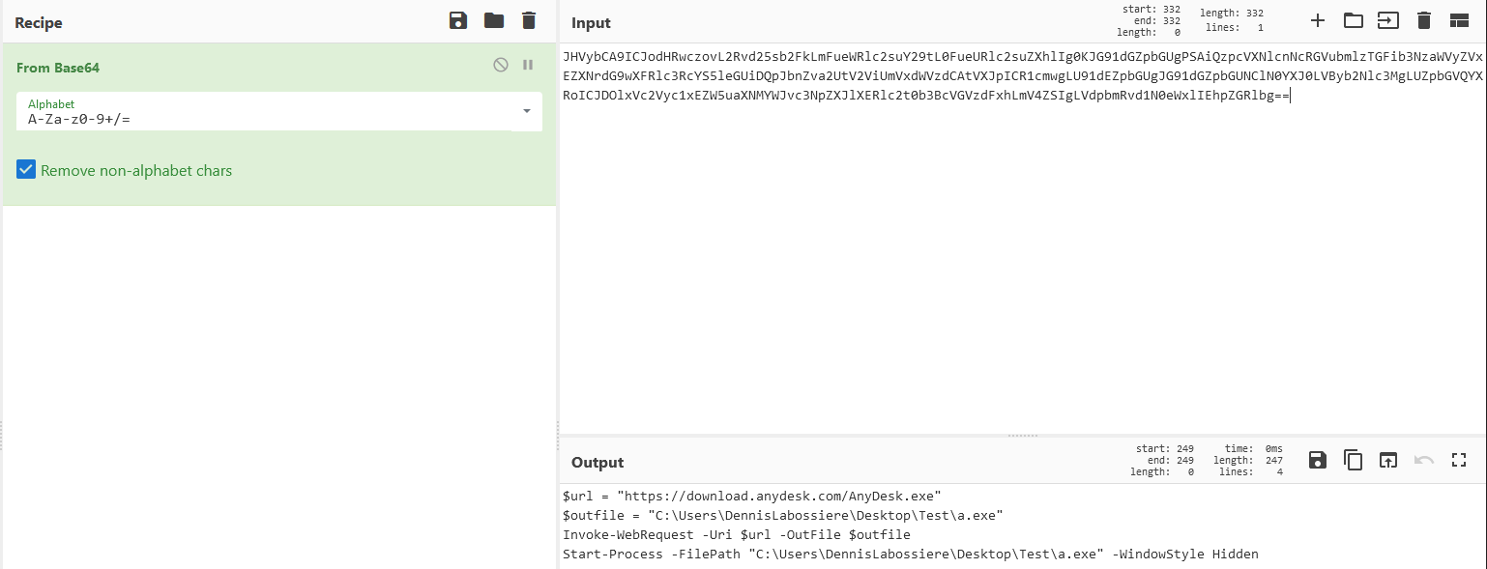
Forensic analysis – Decoding script contents
Using CyberChef, we can decode the Base64 contents with ease.
REDACTED

Slide 30
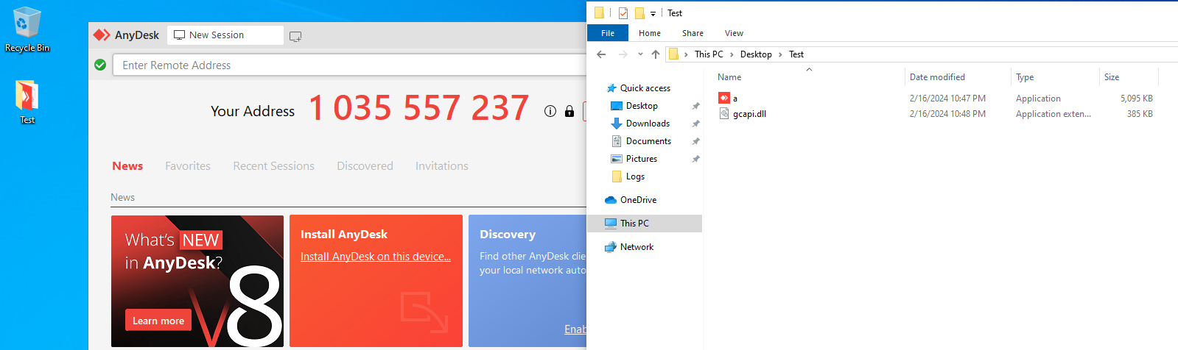
Forensic analysis – Results on the end point
Intune policy hash

Slide 31
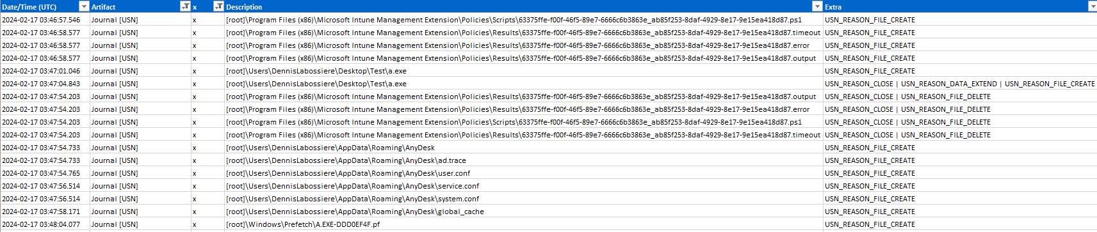
Forensic analysis – $UsnJrnl/$J
Provides the most insight into file creation, modification, and deletion events:
Recorded the creation and deletion for the PowerShell .PS1, .timeout, .error, and .output files.

Slide 32
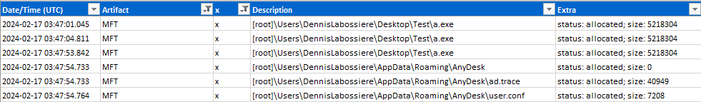
Forensic analysis – $MFT
Like the $J, the $MFT records file creation, modification, and access times:
Does not show the creation or deletion of the PowerShell .PS1, .timeout, .error, and .output files.
Unlike the $J, the $MFT shows file sizes.

Slide 33
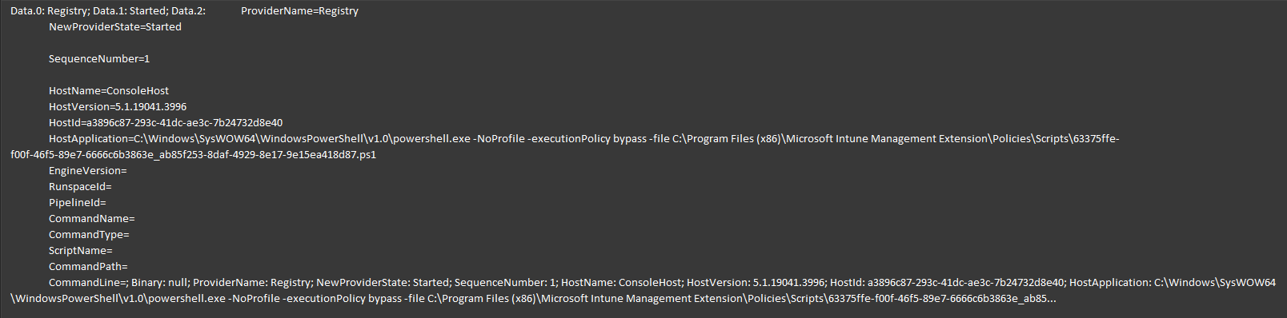
Forensic analysis – PowerShell event logs
Indicates PowerShell is running.
May show the content of the script(s):
Depends on logging policy.

Slide 34
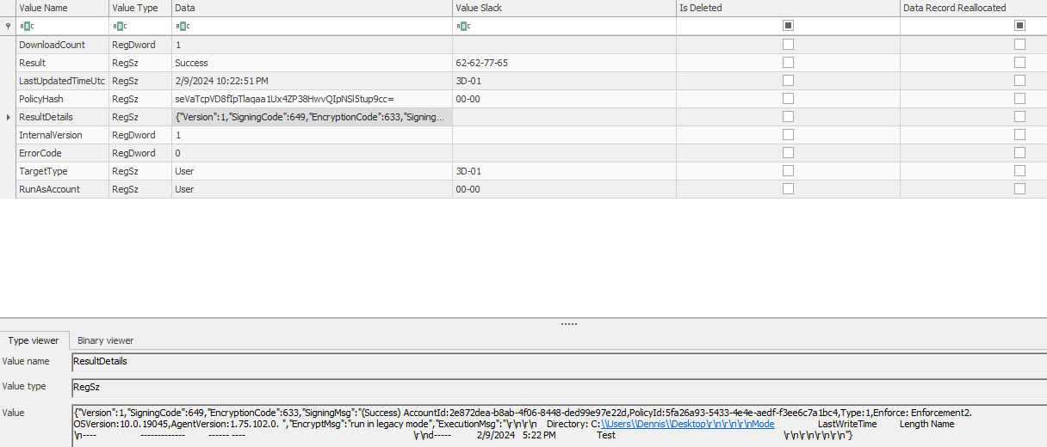
Forensic analysis – Registry – Test Intune script
HKLM\SOFTWARE\Microsoft\IntuneManagementExtension\Policies\63375ffe-f00f-46f5-89e7-6666c6b3863e\5fa26a93-5433-4e4e-aedf-f3ee6c7a1bc4

Slide 35
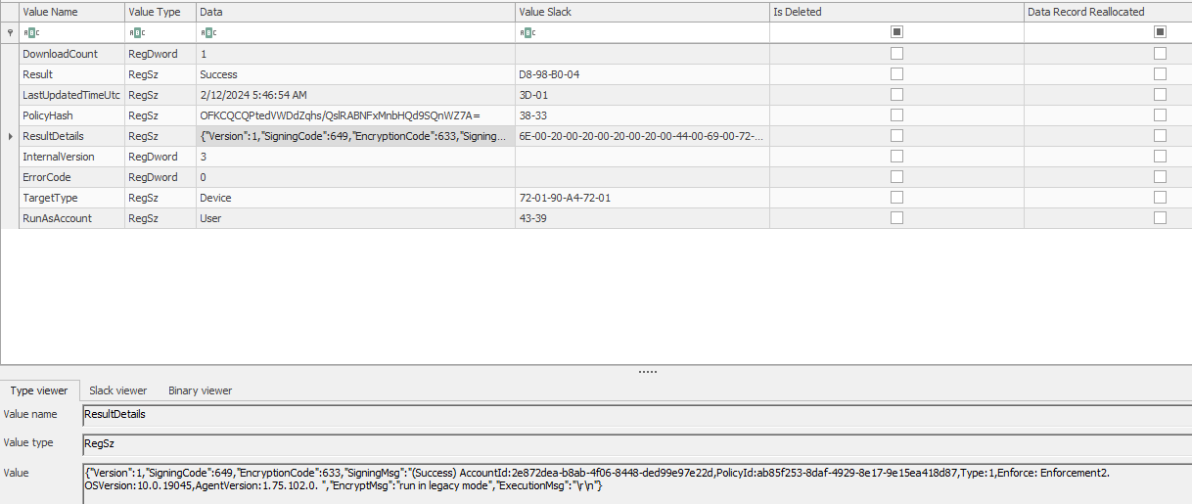
Forensic analysis – Registry – Modified Intune script
HKLM\SOFTWARE\Microsoft\IntuneManagementExtension\Policies\63375ffe-f00f-46f5-89e7-6666c6b3863e\ab85f253-8daf-4929-8e17-9e15ea418d87

Slide 36
Forensic analysis – Intune-specific logs
C:\Program Files (x86)\Microsoft Intune Management Extension\Policies\Scripts\
Contains a PowerShell script that is downloaded then executed from Intune:
This script is deleted after a successful push from Intune to the endpoint.
The PS1 file the $J recorded.
C:\Program Files (x86)\Microsoft Intune Management Extension\Policies\Results\
Contains files that record the results of the script executions:
These files are also deleted after a successful execution of the PowerShell script (even if the script itself errors out).
The .error, .output, and .timeout files the $J recorded.
C:\ProgramData\Microsoft\IntuneManagementExtension\Logs\
Contains both the AgentExecutor.log and IntuneManagementExtension.log files:
AgentExecutor.log appears to record the results of stdout.
IntuneManagementExtension.log appears to record the contents of the PS1 file.

Slide 37
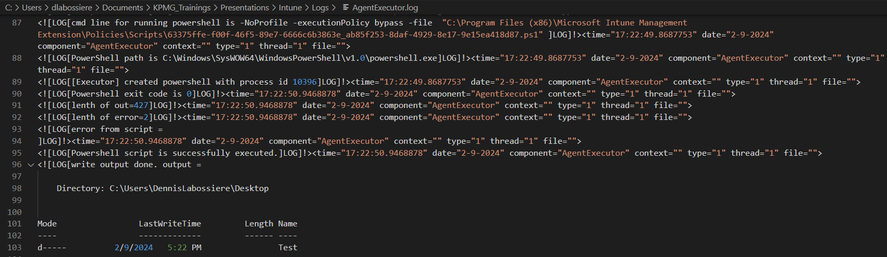
Forensic analysis – AgentExecutor.log
Below is a snippet from the AgentExecutor.log file. The times within the log are local system time.
Note: The two GUIDs (Azure user Object ID and Intune scriptID).

Slide 38
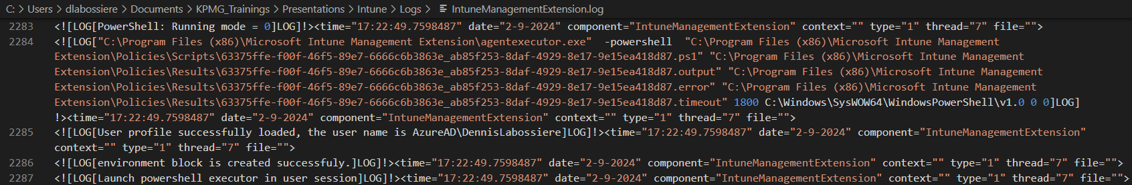
Forensic analysis – IntuneManagementExtension.log
A snippet from the IntuneManagementExtension.log file
Note: The two GUIDs (Azure user Object ID and Intune scriptID).
In this snippet, the PolicyId (aka scriptID), the PolicyHash (from the Registry), and the PolicyBody (plain text of the script contents) are logged.

Slide 39
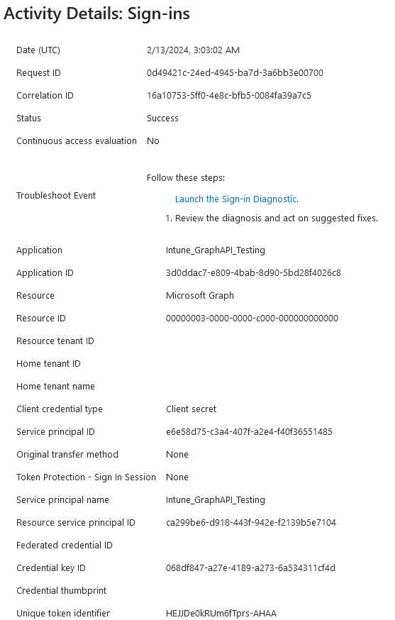
Forensic analysis – Azure logging
Microsoft Entra ID Sign-in Log
Service Principal sign-ins detail application activity (Graph API):
The Service principal ID is the Object ID from the Enterprise Application pane.
The Credential key ID is the Secret ID from the Registered Application pane.
The Resource service principal ID tied back to GraphAggregatorService (aka Microsoft Graph).
REDACTED
REDACTED
REDACTED
REDACTED

Slide 40
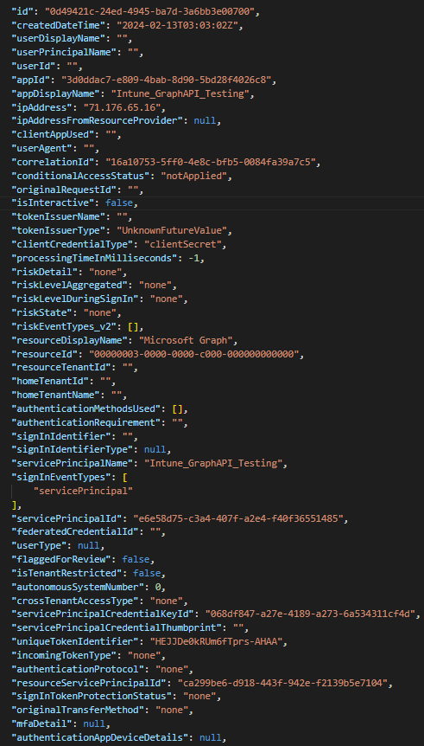
REDACTED
REDACTED
Azure sign-in logs
REDACTED
Graph API JSON results
REDACTED
REDACTED
REDACTED
REDACTED
REDACTED
REDACTED
REDACTED
REDACTED

Slide 41
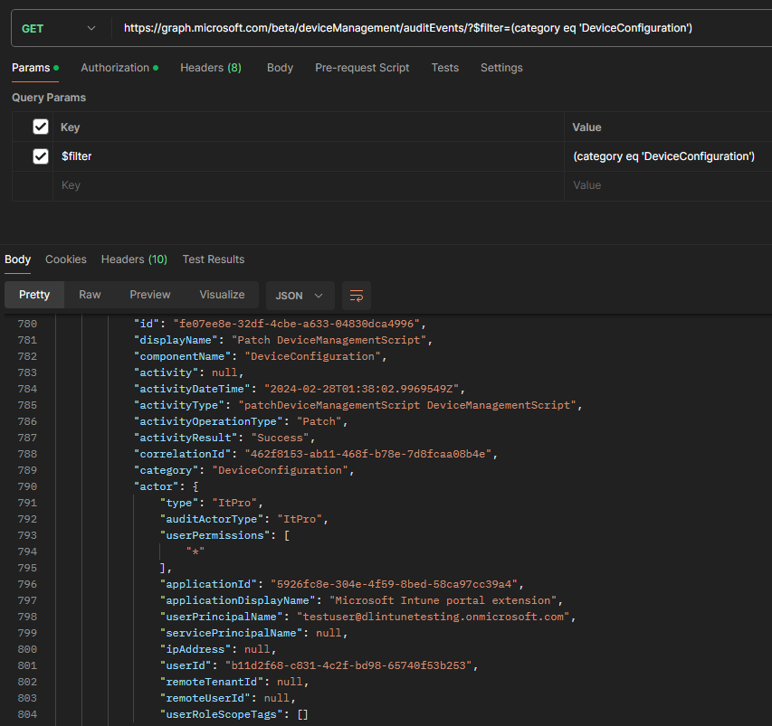
What happens to modified scripts?
If User B modifies a script created by User A, then the Intune audit log will log this activity. However, on the endpoint, it will still look as though User A executed the script:
Microsoft logs a change to an Intune script as patchDeviceManagementScript.
Send a GET to https://graph.microsoft.com/ beta/deviceManagement/auditEvents to obtain Intune audit log events:
Look at the DeviceConfiguration category.

Slide 43
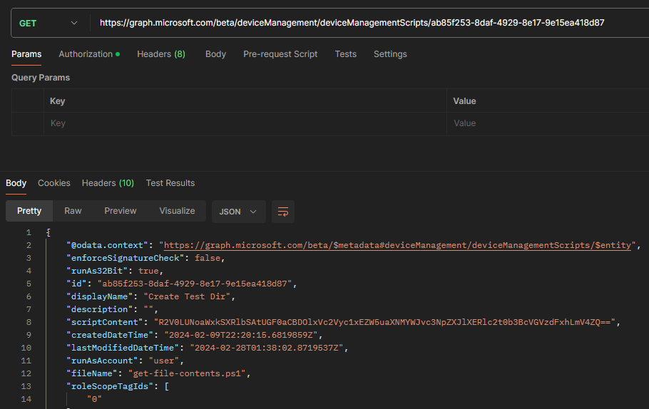
SCRIPT MODIFIED BY USER B

Slide 44
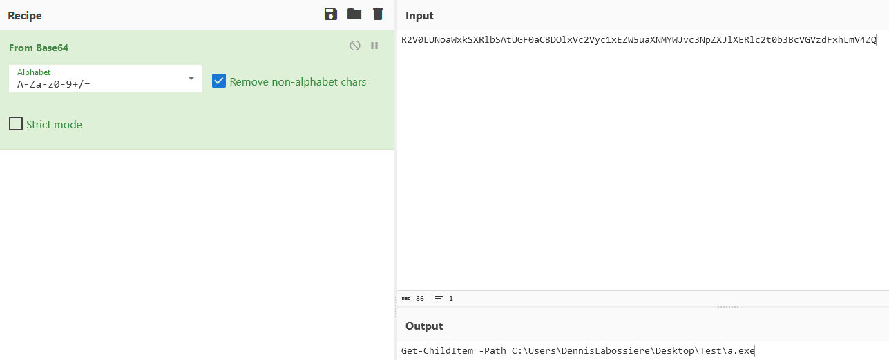
Decoding script contents (continued)
Using CyberChef, we can decode the Base64 contents with ease.
REDACTED

Slide 45
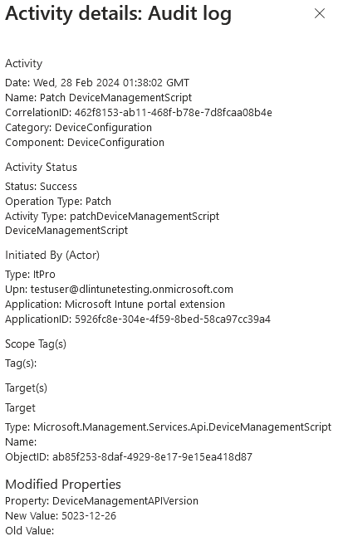
Forensic analysis – Intune logging
Microsoft Intune Audit Log:
Patch DeviceManagementScript denotes a modified script.
Upn is the user that performed the modification.
ObjectID is the scriptID for the modified script.

Slide 46
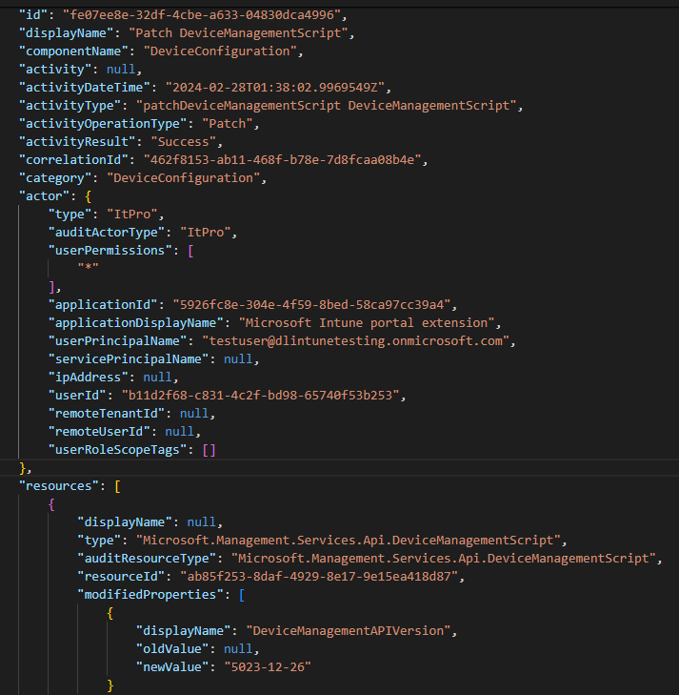
Intune audit logs
Graph API JSON results

Slide 47
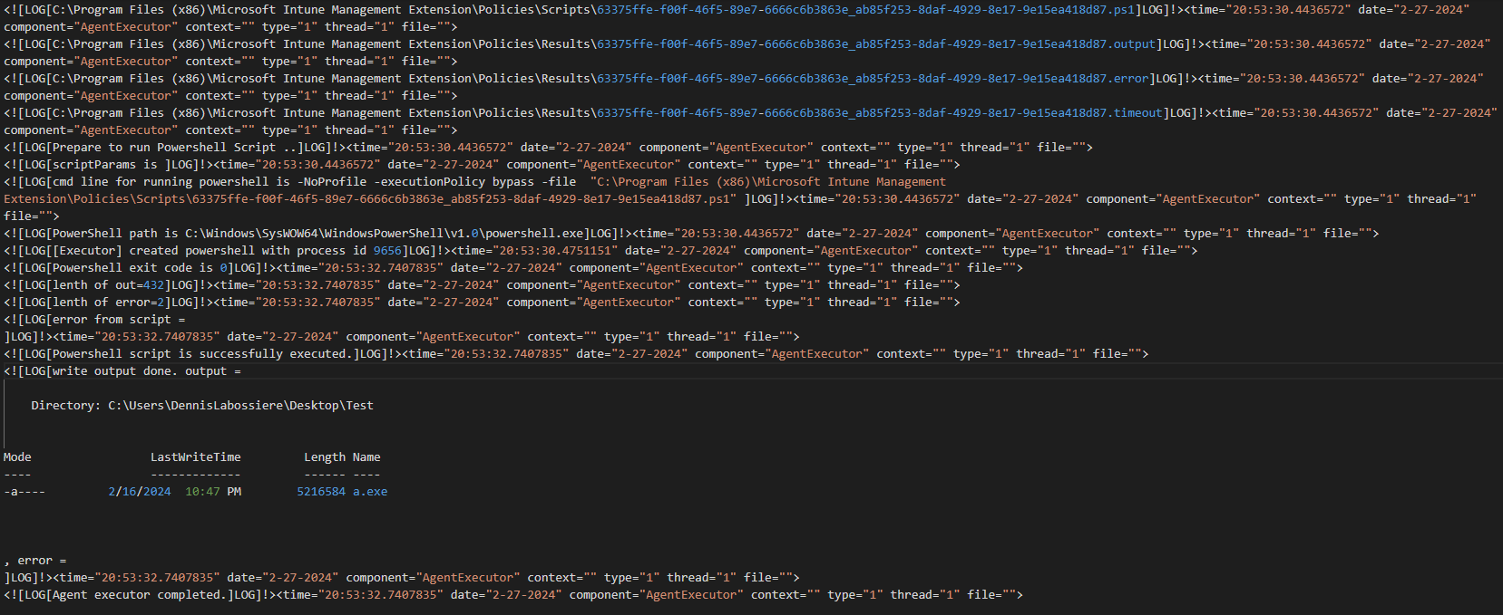
Forensic analysis – AgentExecutor.log (continued)
Another snippet from the AgentExecutor.log file again detailing the results of the script. Remember: User B modified the script, yet this event is still tied to User A

Slide 48
Tools used
4

Slide 49
Tools and resources
Tools used within this presentation:
KPMG Digital Responder (KDR v4.1.8)
Local copy of CyberChef (v10.5.2)
Eric Zimmerman’s Registry Explorer (v1.6.0.0)
https://github.com/dllaboss/ MSFT_Intune_Analysis
Script
Registry Explorer bookmark
Resources leveraged to build this presentation:
Azure Portal
Intune Management Portal
Azure Graph API:
https://graph.microsoft.com/beta/deviceManagement/deviceManagementScripts
https://graph.microsoft.com/beta/auditLogs/signins?$filter=(signInEventTypes/any(t:t+eq+%27servicePrincipal%27)
https://graph.microsoft.com/beta/deviceManagement/auditEvents/?$filter=(category eq ‘DeviceConfiguration’)

Slide 50
Research
5

Slide 51
Research
Articles and blogs leveraged to build this presentation:
01
Deep dive Microsoft Intune Management Extension – PowerShell Scripts
(https://oliverkieselbach.com/2017/11/29/deep-dive-microsoft-intune-management-extension-powershell-scripts) – Oliver Kieselbach
02
Download Intune PowerShell scripts with Graph Explorer
(https://janbakker.tech/download-intune-powershell-scripts-with-graph-explorer/) – Jan Bakker
03
Microsoft Intune securely manages identities, manages apps, and manages devices
(https://learn.microsoft.com/en-us/mem/intune/fundamentals/what-is-intune) – Microsoft Learn
04
Microsoft Sentinel – Custom Data Connector for Microsoft Intune
(https://infosecwriteups.com/microsoft-sentinel-custom-data-connector-for-microsoft-intune-04b19b7e0006) – Usama Saleem
05
Step-by-step guide to create a lab and enroll the devices with Intune by using AutoPilot
(https://www.alexandrumarin.com/step-by-step-guide-to-create-a-lab-and-enroll-the-devices-with-intune-by-using-autopilot/) – Alexandru Marin
06
Unable to get Sign-Ins for Service Principal using Microsoft Graph API
(https://stackoverflow.com/questions/67302812/unable-to-get-sign-ins-for-service-principal-using-microsoft-graph-api) – StackOverflow user Minkus

Slide 52
Summary
6

Slide 53
Wrap-up
Provided a brief background of the incident that inspired this presentation.
Detailed how to baseline an Intune environment, pull information from the Graph API, and decode Base64-encoded PowerShell scripts.
Analyzed the $UsnJrnl/$J and $MFT, PowerShell event logs, Windows registry hive, specific Intune logs, Azure Service Principal sign-in logs, and Intune audit logs:
Detailed the connection between Azure, Intune, and forensic artifacts on the endpoint
Provided the tools used for analysis.
Provided the research that assisted with building the test environment and understanding what Intune-specific logging is present on a Windows endpoint and within Azure.

Slide 54
Questions

Slide 55

Thank you
“
This goes without saying, but I want to give a big shout-out to my wife and family for their support and words of encouragement during this process.
I would like to thank those who worked on the engagement that inspired this presentation.
Thank you to the KPMG Cyber Threat Management partners for their blessing and support.
Thank you to my mentors for their guidance and support.
Thank you to the audience and future readers/researchers using this presentation for their research.

Slide 56

About KPMG Cyber Threat Management
Dennis Labossiere Director dlabossiere@kpmg.com linkedin.com/in/dennisleolabossiere https://github.com/dllaboss/ X: @dlabos
We help clients prevent, detect, respond to, and recover from cyber incidents.
For more information about our services, find us on the KPMG Cyber Security Services site.

Slide 57
Some or all of the services described herein may not be permissible for KPMG audit clients and their affiliates or related entities.
The information contained herein is of a general nature and is not intended to address the circumstances of any particular individual or entity. Although we endeavor to provide accurate and timely information, there can be no guarantee that such information is accurate as of the date it is received or that it will continue to be accurate in the future. No one should act upon such information without appropriate professional advice after a thorough examination of the particular situation.
© 2025 KPMG LLP, a Delaware limited liability partnership and a member firm of the KPMG global organization of independent member firms affiliated with KPMG International Limited, a private English company limited by guarantee. All rights reserved. USCS026964-1A
The KPMG name and logo are trademarks used under license by the independent member firms of the KPMG global organization.

